Slide 1
New York Housing Data
Meda Pravallika

Slide 2


Agenda
A
Overview
Dataset Summary
Scope of the project
Machine Learning
Architecture Of New yourk Housing Dataset
Power BI Dashboard
Conclusion

Slide 3
Overview
This dataset contains prices of New York houses, providing valuable insights into the real estate market in the region. It includes information such as broker titles, house types, prices, number of bedrooms and bathrooms, property square footage, addresses, state, administrative and local areas, street names, and geographical coordinates.

Slide 4
Data Summary
Your dataset contains information about New York houses, including broker titles, house types, prices, number of bedrooms and bathrooms, property square footage, addresses, and geographical coordinates.
You've performed data cleaning tasks like checking for missing values, duplicates, and outliers.
Exploratory Data Analysis (EDA):
You've visualized the distribution of numerical features like price, number of bedrooms, number of bathrooms, and property square footage.
Explored categorical features like house type and locality.
Investigated relationships between features, such as the average price for different types of houses and the distribution of baths and bedrooms.

Slide 5
Scope Of Project
Prediction Accuracy: The mean squared error (MSE) values indicate the average squared difference between predicted and actual prices. Lower MSE values suggest better prediction accuracy. In this case, the Random Forest Regression model has the lowest MSE, indicating relatively better performance compared to other models in terms of prediction accuracy.
Model Fit: The R-squared score represents the proportion of the variance in the dependent variable that is predictable from the independent variables. Higher R-squared values indicate better model fit. In this case, the Random Forest Regression model again outperforms the other models with the highest R-squared score, indicating that it explains more variance in the data.
Scope: Despite the challenges posed by the unpredictability of housing prices, the project demonstrates the potential of machine learning techniques to provide valuable insights and predictions in the real estate market. By further refining the models and exploring additional features, the scope of the project could be expanded to enhance prediction accuracy and provide more reliable forecasts for investors and stakeholders in the New York housing market.

Slide 6
Machine Learning
You've split the data into training and testing sets.
Trained multiple regression models like Linear Regression, Decision Tree Regression, Random Forest Regression, Support Vector Regression, and K-nearest neighbors.
Evaluated the performance of these models using metrics like Mean Squared Error (MSE) and R-squared score.
Visualized the predicted vs actual prices for each model to understand their performance.

Slide 7
ML Models
Linear Regression
Decision Tree Regression
Random Forest Regression
Support Vector Regression
Naive Bayes Accuracy
k-nearest neighbours Regressors

Slide 8
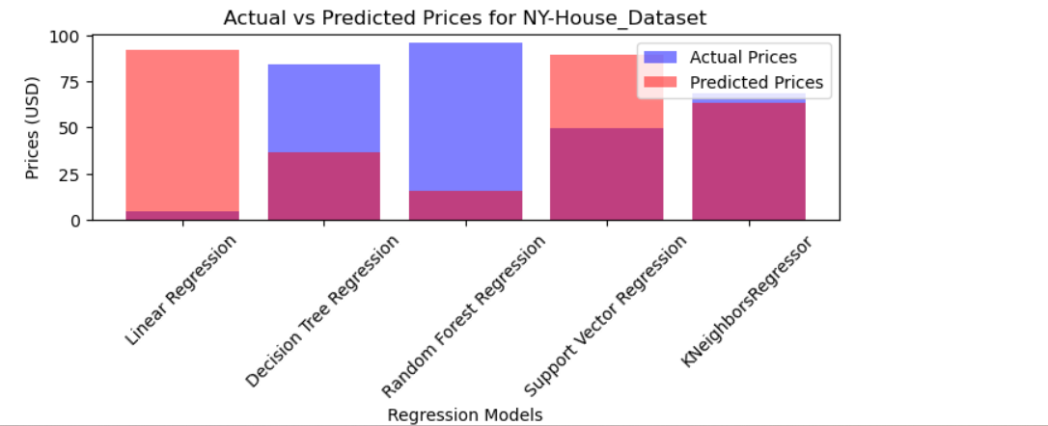
Bar Graph related to all models

Slide 9
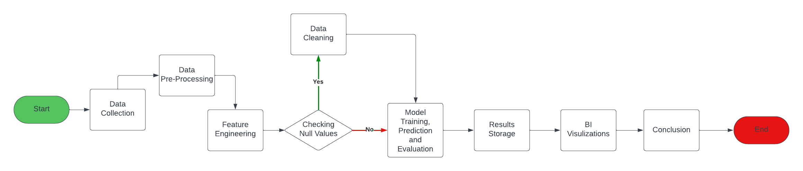
Architecture Of New York Housing Dataset

Slide 10
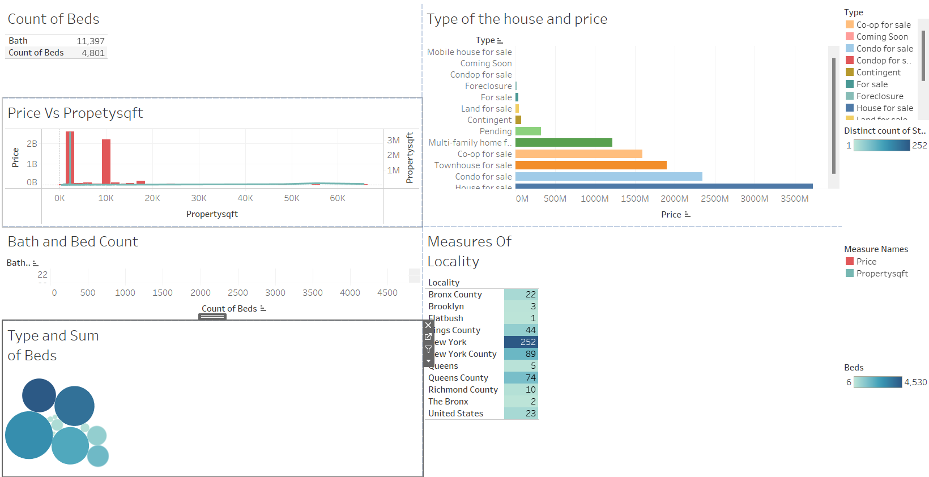
Power BI Dashboard

Slide 11
Conclusion
The analysis demonstrates the potential of machine learning techniques in predicting housing prices, providing valuable insights for investors, real estate professionals, and stakeholders.
By leveraging advanced algorithms and further refining the models, the accuracy of predictions can be enhanced, aiding in decision-making processes related to property investment, valuation, and market trends.
The project highlights the importance of data-driven approaches in understanding and navigating the complexities of the real estate market, offering opportunities for informed decision-making and risk management.
In conclusion, the New York housing dataset analysis underscores the significance of data analytics and machine learning in the real estate industry, empowering stakeholders with actionable insights and predictive capabilities to navigate market dynamics and make informed decisions.

Slide 12
Thank you
Meda Pravallika​
medapravallika12@gmail.com

